Slide 1

What Helps Students Succeed in Online Classes?
A Data-Driven Analysis
Final Project – IS 362
Shakhyry Walsh
12/7/2025
Notes:
This project explores which factors most strongly influence how well students perform in online classes. As someone who wants to be a professor, understanding what actually helps students succeed and whether 'effort' (like login frequency and study hours) directly translates to higher grades.

Slide 2
Motivation
Online learning is becoming more common.
Student success varies widely in online formats.
Instructors often don’t know which factors matter most.
I wanted to analyze real behavioral patterns and discover what drives outcomes.
Notes:
Online learning keeps growing, but students don’t always perform equally well in this format. I wanted to understand what really matters, whether it be participation, access to resources, instructor feedback, or student habits, so we can design better online courses.

Slide 3
Data Sources
Internal Data: logins, submissions, discussions, grades, demographics
External Data: National Engagement Benchmarks (comparing majors to national averages).
Synthetic IDs: because the dataset is simulated and privacy-safe
Notes:
I used five interconnected datasets that mimic a real learning management system: student demographics, login activity, assignment submissions, discussion posts, and final grades. These datasets give a full picture of how students behave throughout the course. I combined internal CSV logs with external benchmark data on study habits by major.

Slide 4
Workflow
Clean timestamps and calculate weekly participation
Merge all datasets into a single master table
Create features like login frequency, study hours, discussion activity
Analyze correlations and patterns
Build a simple predictive model
Notes:
My workflow follows a standard data analytics process. I cleaned and transformed the raw data, merged all sources together, engineered meaningful features, and then performed statistical analysis to discover which factors predicted final grades.

Slide 5
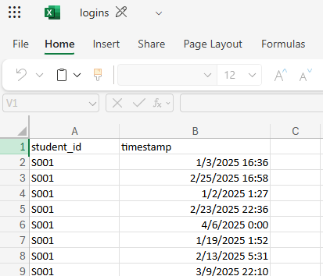
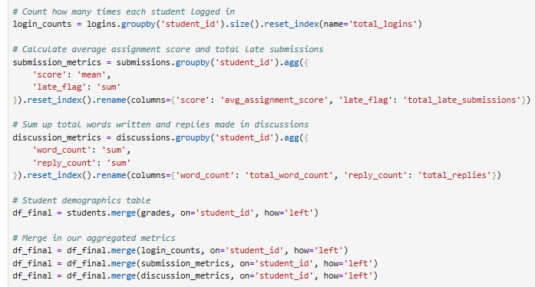
The Challenge
Notes:
The biggest technical challenge was that the raw data was transactional, one student had dozens of individual login rows. I had to write aggregation logic in Python to group these by student_id and calculate metrics like 'Total Logins' and 'Average Assignment Score' before I could merge them.

Slide 6
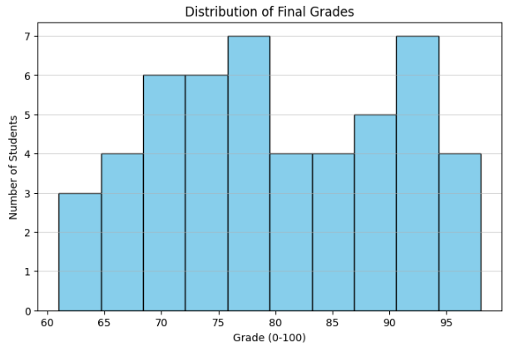
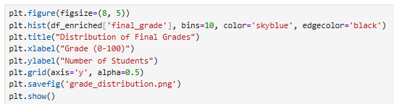
Descriptive Analysis
Notes:
First, I validated the data. This histogram shows a normal distribution of grades, confirming the data was clean enough for analysis.

Slide 7
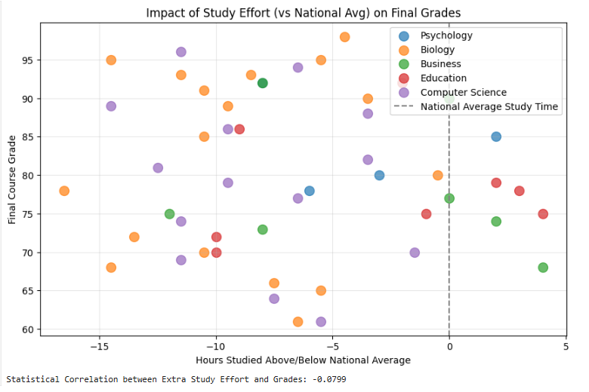
Key Insight
Notes:
Here was the surprising insight. I calculated an 'Effort Gap' to see if students who study more than the national average get better grades. As you can see, the correlation is essentially zero (-0.08). This suggests that sheer hours spent studying is not the primary driver of high grades in this course.

Slide 8
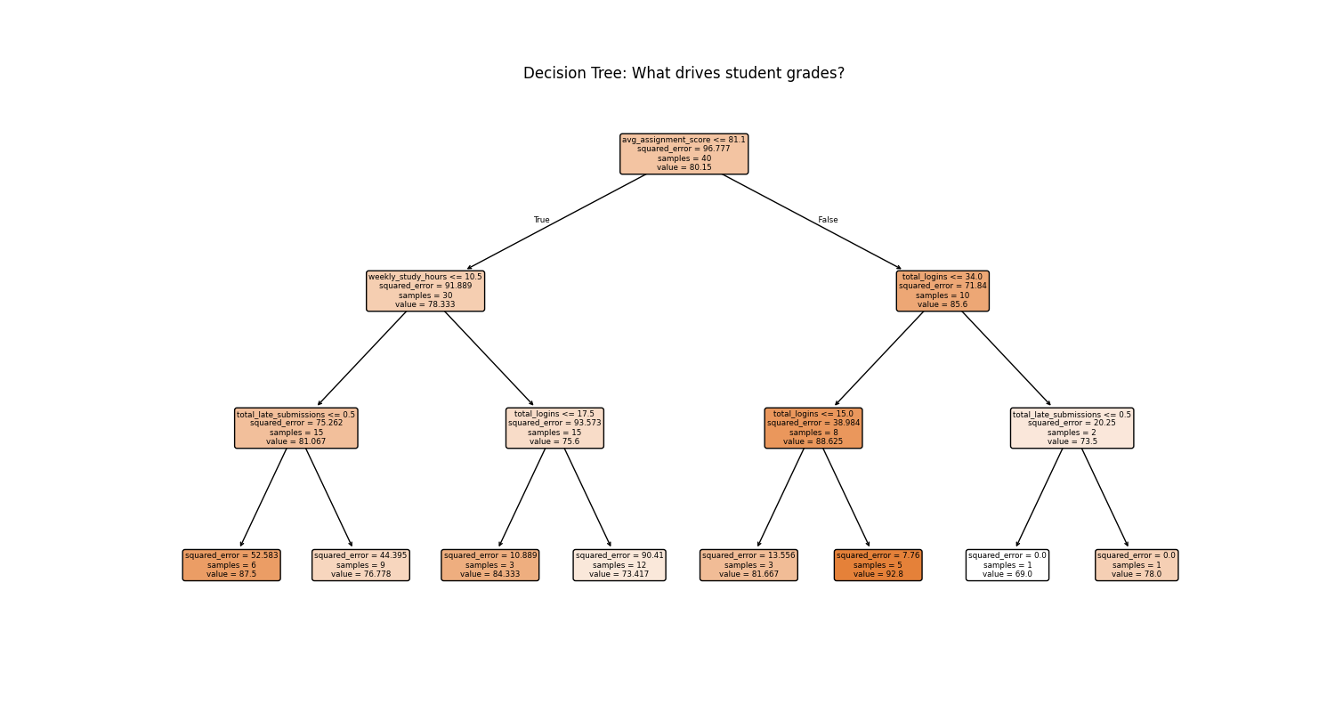
Advanced Analysis
Notes:
To go deeper, I implemented a Decision Tree Regressor using scikit-learn. Instead of just looking at correlations, this model attempts to predict a student's final grade based on their activity metrics. It successfully identified that 'Average Assignment Score' was a stronger predictor than study hours.

Slide 9
Conclusion
Quality of Engagement Matters More Than Quantity
Key Findings
Hypothesis Rejected: My analysis found no significant correlation (-0.08) between studying more than the national average and achieving higher grades.
The "Effort Gap" Fallacy: Students who logged excessive hours did not automatically outperform their peers.
Predictive Model Insight: The Decision Tree model identified Average Assignment Score as the #1 predictor of a high final grade, outweighing login frequency or study duration.
Future Recommendations
For Students: Focus on mastering early assignments rather than just logging "seat time."
For Instructors: Early intervention should target students with low assignment scores, not just those with low login activity.

